Slide 2
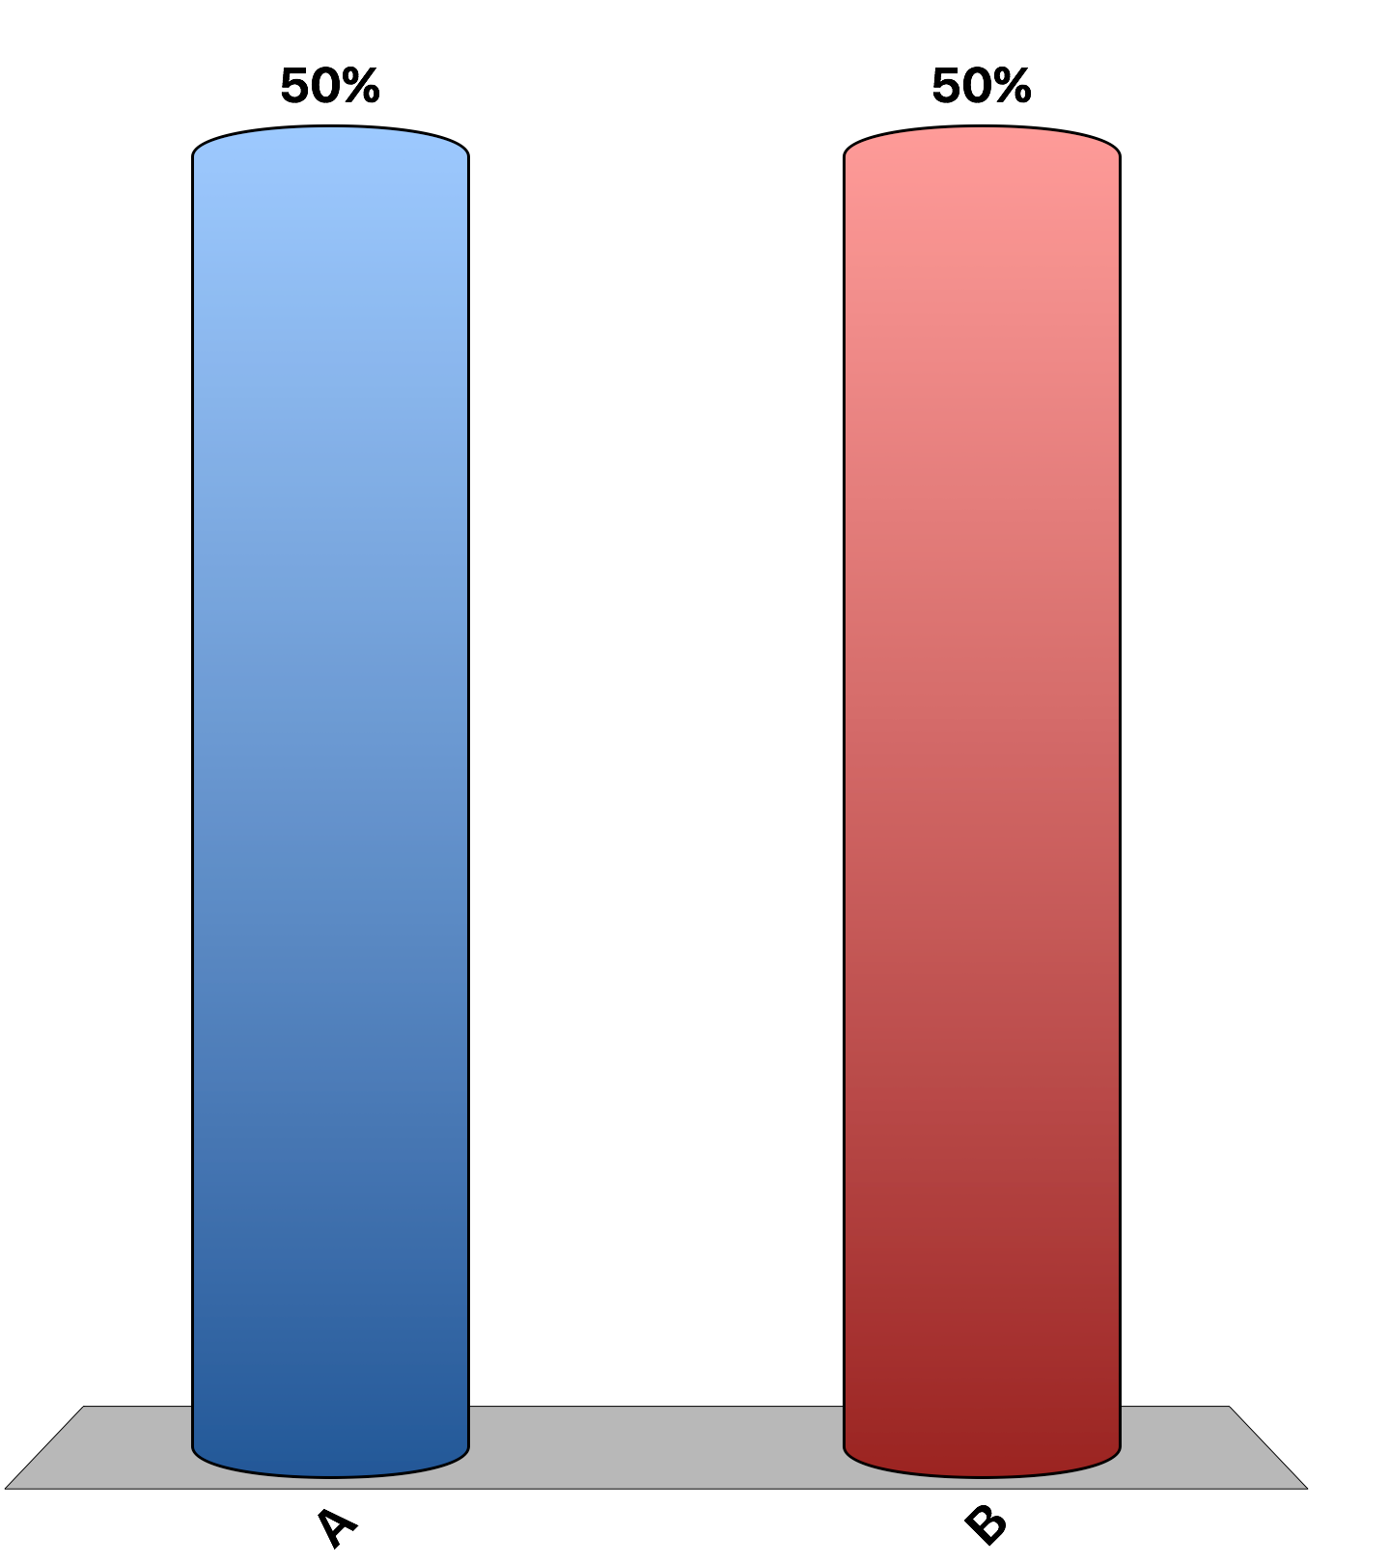
Consumers in an importing country would benefit from the imposition of a tariff.
True
False

Slide 3
Using a tariff to protect developing industries until they mature and are able to compete with foreign firms benefits all consumers and producers in the domestic country.
True
False

Slide 4
The world price of feta cheese is below the price that would prevail in Greece in the absence of trade. With free trade, Greece would become an importer of feta cheese.
True
False

Slide 5
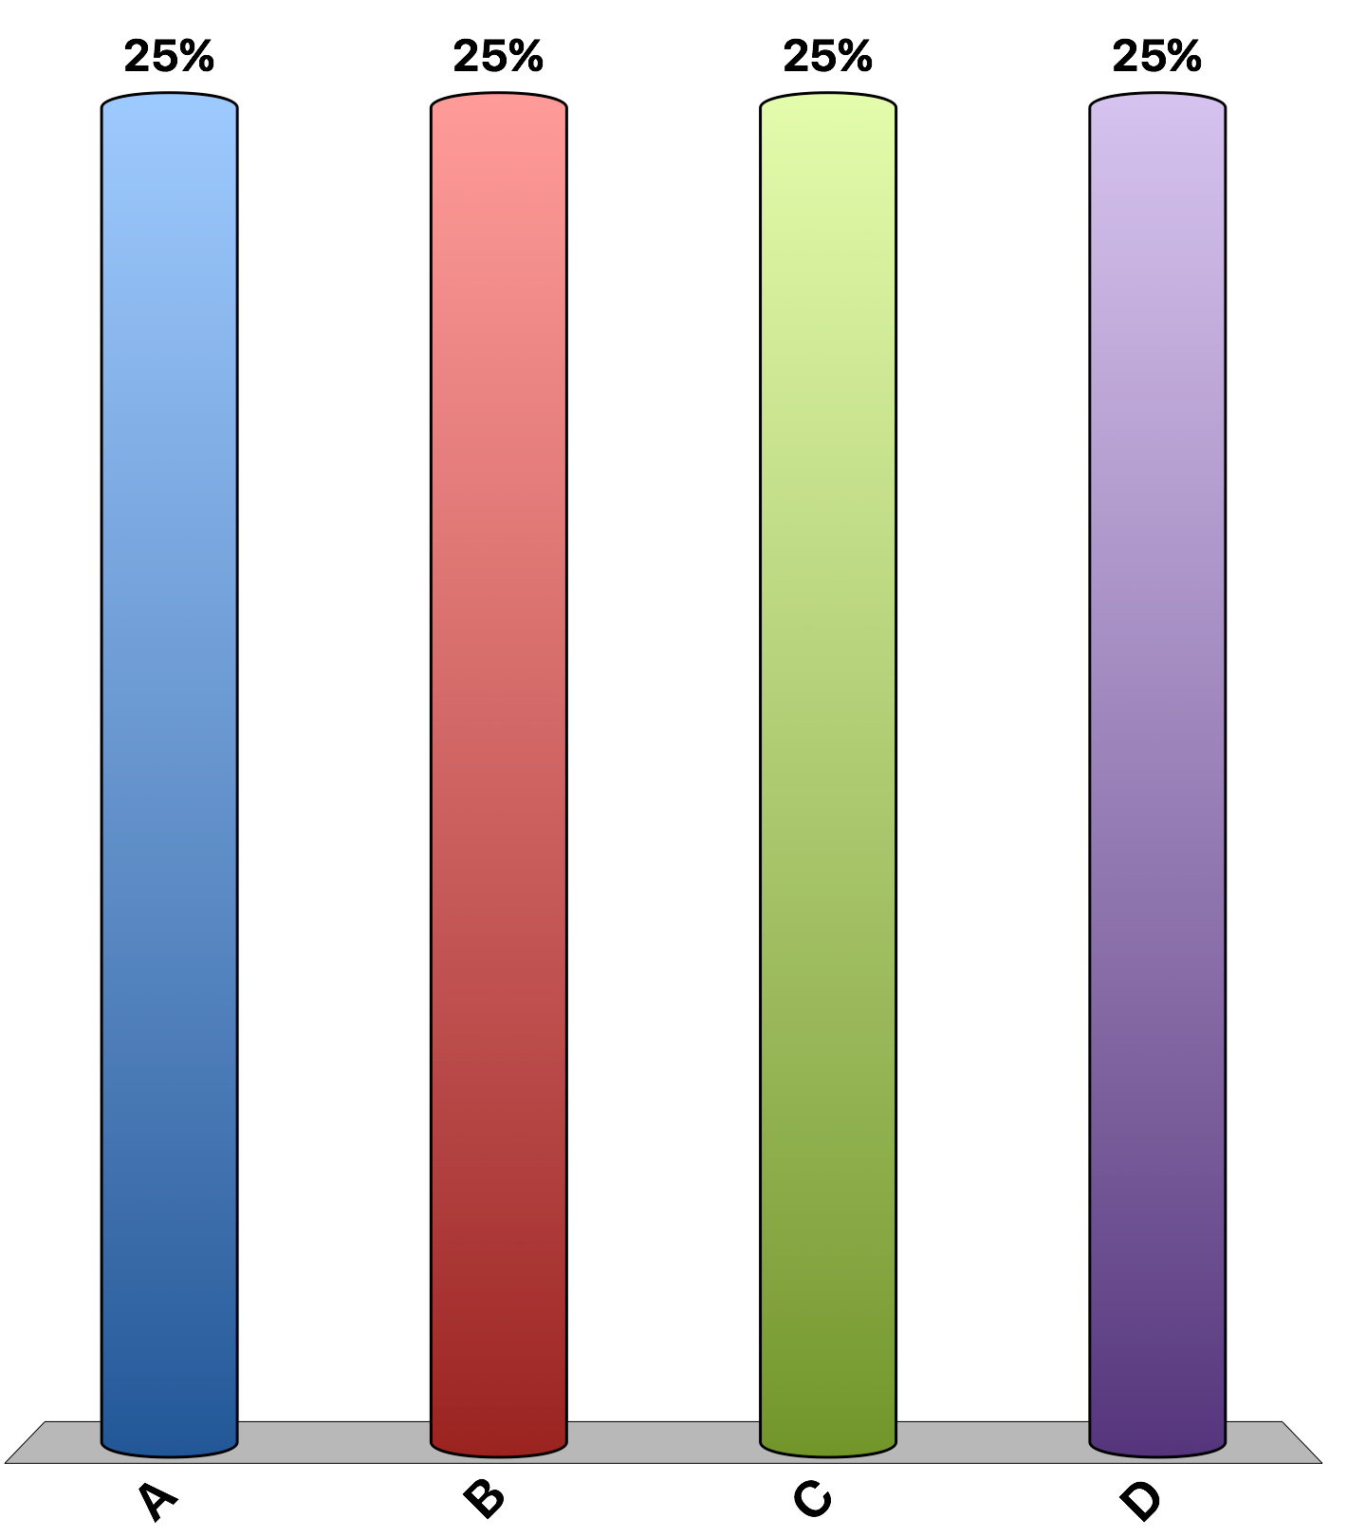
When a country allows trade and becomes an exporter of a good
producer surplus from that good rises and consumer surplus from that good falls.
producer and consumer surplus from that good rise.
producer and consumer surplus from that good fall.
producer surplus from the good falls, and consumer surplus from that good rises.

Slide 6
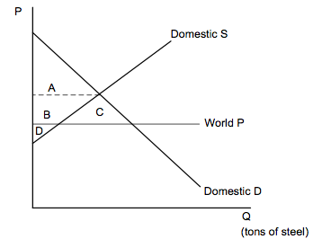
Italy's steel market is represented in the graph. When Italy begins to trade with other countries, it will increase
exports of steel until the domestic price falls to the world price.
exports of steel until the world price rises to the domestic price.
imports of steel until the world price rises to the domestic price.
imports of steel until the domestic price falls to the world price.

Slide 7
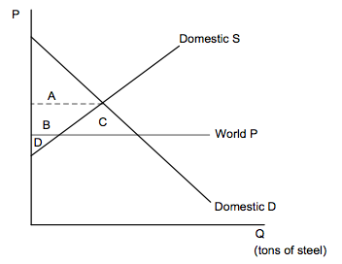
Refer to the graph. If the country shown does not engage in trade, consumer surplus is area
A.
B.
C.
A + B + C

Slide 8
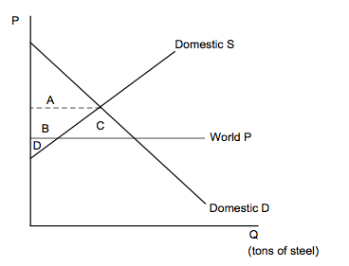
Refer to the graph. If the country shown engages in trade, consumer surplus is area
A.
A+B.
A+B+C.
A+B+D.

Slide 9
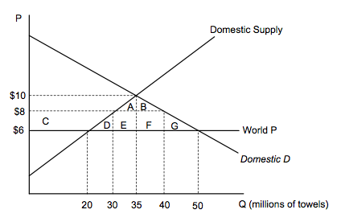
Sweden’s market for towels is represented in the graph. If the Swedish government imposes a $2 tariff on the import of towels, the price and quantity purchased on the domestic market would be:
$8, 40
$8, 30
$6, 20
$6, 50

Slide 10
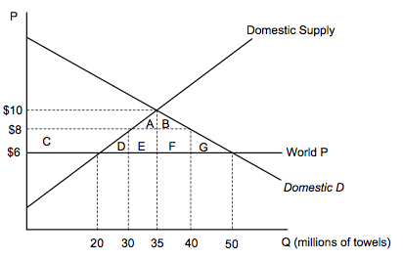
In the graph, the deadweight loss from the imposition of a $2 tariff is area
A + B + D + E + F + G
D + E + F + G
C + D + E + F + G
D + G

Slide 11
A U.S. tariff on the import of sugar makes the domestic price of sugar
and U.S. consumer surplus higher.
higher and U.S. consumer surplus lower.
lower and U.S. consumer surplus higher.
and U.S. consumer surplus lower.

Slide 12
A U.S. tariff on the import of sugar means that domestic producers of sugar
sell more and have a higher revenue.
sell more but have a lower revenue.
sell less but have a higher revenue.
sell less and have a lower revenue.

Slide 13
Opponents of free trade often argue that trade with other countries destroys domestic jobs. If you are a proponent of free trade, what would your argument be?
free trade creates jobs in the industries we have comparative advantage.
free trade allows the society to enjoy a higher standard of living as a whole.
workers that lost their jobs because of free trade will eventually find jobs in the industries we have comparative advantage.
All of the above are good arguments for free trade.

Slide 14
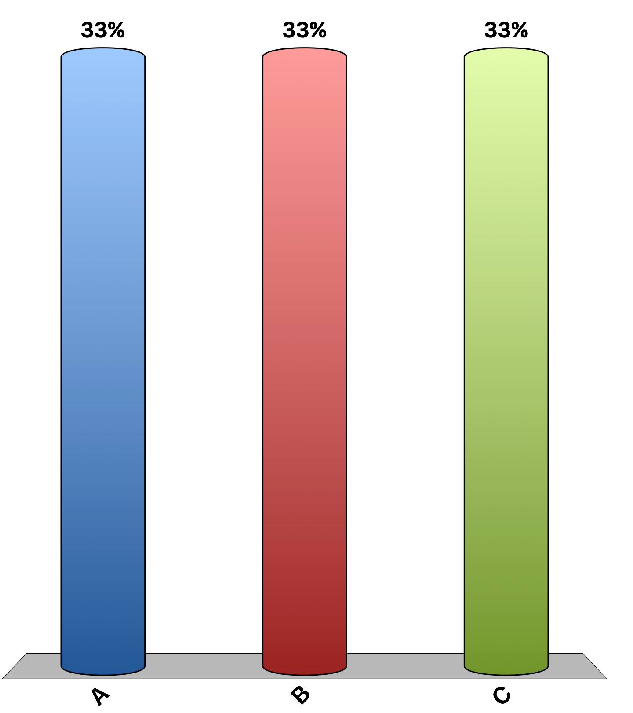
“Past major trade deals have benefited most Americans.”
agree
disagree
uncertain
Notes:
93% of economists agree, 0% disagree, and 7% are uncertain. This is the 'Ask the experts' feature in the textbook. Source: IGM Economic Experts Panel, November 11, 2014 and March 27, 2013.

Slide 15
“Refusing to liberalize trade unless partner countries adopt new labor or environmental rules is a bad policy, because even if the new standards would reduce distortions on some dimensions, such a policy involves threatening to maintain large distortions in the form of restricted trade.”
agree
disagree
uncertain
Notes:
49% of economists agree, 25% disagree, and 26% are uncertain. This is the 'Ask the experts' feature in the textbook. Source: IGM Economic Experts Panel, November 11, 2014 and March 27, 2013.

